Slide 1
PRESENTED BY
KANIKA B
au2282170004
BE-CSE
3RD YEAR
balasubramaniyankanika578@gmail.com
SIR ISSAC NEWTON COLLEGE OF ENGINEERING AND TECHNOLOGY
NAGAPATTINAM – 611 102.

Slide 2
DATA VISUALIZATION

Slide 3
AGENDA
Introduction
Approach
Data Collection and Preparation
What is data exploration?
Requirements
Visualization algorithm
Result
Conclusion
References

Slide 4
INTRODUCTION:
There has been the need for displaying massive amounts of data in a way that is easily accessible and understandable. Organizations generate data every day. As a result, the amount of data available on the Web has increased dramatically. It is difficult for users to visualize, explore, and use this enormous data. The ability to visualize data is crucial to scientific research. Today, computers can be used to process large amounts of data. Data visualization is concerned with the design, development, and application of computer generated graphical representation of the data. It provides effective data representation of data originating from different sources. This enables decision makers to see analytics in visual form and makes it easy for them to make sense of the data. It helps them discover patterns, comprehend information, and form an opinion.

Slide 5
APPROACHES:
here is a variety of conventional ways to visualize data - tables, histograms, pie charts and bar graphs are being used every day, in every project and on every possible occasion.
However, to convey a message to your readers effectively, sometimes you need more than just a simple pie chart of your results.
In fact, there are much better, profound, creative and absolutely fascinating ways to visualize data. Many of them might become ubiquitous in the next few years.

Slide 6
DATA COLLECTION AND PREPARATION:
Data Sources:
Describe the sources from which you obtained the data. This could include databases, APIs, websites, surveys, etc. Provide information on the origin and reliability of the data sources. Discuss any potential biases or limitations inherent in the data.
Data Acquisition:
Data acquisition (DAQ) is the process of measuring an electrical or physical phenomenon, such as voltage, current, temperature, pressure, or sound. A DAQ system consists of sensors, DAQ measurement hardware, and a computer with programmable software such as LabVIEW.
Data Cleaning:
Data cleaning is the process of fixing or removing incorrect, corrupted, incorrectly formatted, duplicate, or incomplete data within a dataset. When combining multiple data sources, there are many opportunities for data to be duplicated or mislabeled.
Data Documentation:
Provide documentation for the cleaned and prepared dataset(s). This could include data dictionaries, codebooks, or metadata describing the variables and their values.

Slide 7
WHAT IS DATA EXPLORATION?
Data exploration refers to the initial step in data analysis in which data analysts use data visualization and statistical techniques to describe dataset characterizations, such as size, quantity, and accuracy, in order to better understand the nature of the data.
‍Data exploration techniques include both manual analysis and automated data exploration software solutions that visually explore and identify relationships between different data variables, the structure of the dataset, the presence of outliers, and the distribution of data values in order to reveal patterns and points of interest, enabling data analysts to gain greater insight into the raw data.
‍Data is often gathered in large, unstructured volumes from various sources and data analysts must first understand and develop a comprehensive view of the data before extracting relevant data for further analysis, such as univariate, bivariate, multivariate, and principal components analysis.

Slide 8
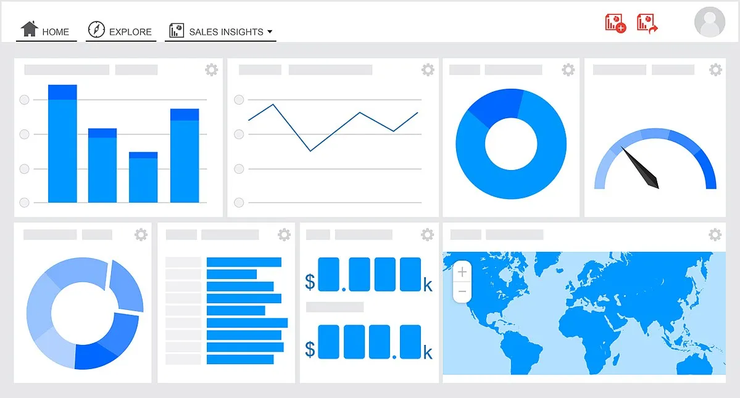
Figure: Data visualization works

Slide 9
REQUIREMENTS:
You must be using Form Tools Core 2.1.0 or later.
This module uses the Google Charts API to generate and render the visualization types.
As such, you will always need to be connected to the internet to see the visualizations. This module will not work offline.You must agree to the Google Charts Terms of Service.
The Quicklinks dialog icon will continue to appear for the administrator and client accounts so you can see what visualizations would normally appear for the form and View, but none of them will actually appear - only the headings.

Slide 10
VISUALIZATION ALGORITHM:
Scatter Plot:
Points are plotted on a graph with one variable on each axis. Algorithms may include techniques for adjusting point sizes, colors, and shapes based on additional variables.
Line Chart:
Points are connected by lines to show trends over time or other ordered categories.
Heatmap:
Algorithms for creating heatmaps involve binning data into a grid and assigning colors based on the density or value within each bin.
Clustering Algorithms:
Used for clustering data points to reveal patterns or groupings within the data. Common algorithms include K-means, hierarchical clustering, and DBSCAN.
Graph Visualization:
Algorithms for visualizing networks or graphs, such as force-directed layouts, spectral methods, and community detection algorithms.

Slide 11
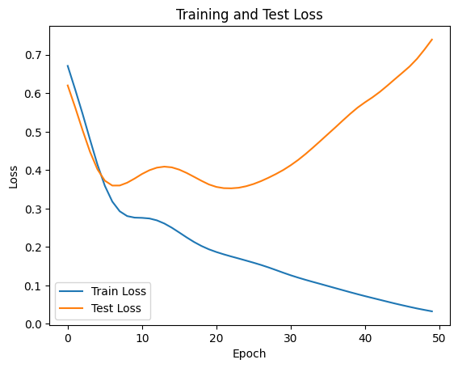
RESULT:

Slide 12
CONCLUSION:
Data Modeling and Visualization make data more valuable to an organization. Data Modeling visualizes the entire or only some parts of an information system to establish the relationship between data points and structures. It shows the relationship between various entities in a database. Data Visualization on the other hand involves presenting data visually using graphics. It helps businesses to extract hidden trends and patterns from data for decision-making. Both Data Modeling and Visualization deal with data and use visual elements to present data, but there are significant differences between the two. Data Modeling techniques include the use of ERD, UML, and Data Dictionaries to present the entities of an information system. Data Visualization techniques involve the use of charts, graphs, and tables to present data visually.

Slide 13
REFERENCES:
1. 44 Types of Graphs Perfect for Every Top Industry.” n.d. https://visme.co/blog/types-of-graphs/#business.
2. “5 Data Visualization Pitfalls.” n.d. https://www.slideshare.net/qlik_arg/5-data-visualization-pitfalls.
3. “8 Ways to Turn Good Data into Great Visualizations.” n.d. https://www.gooddata.com/blog/8-ways-turn-good-data-great-visualizations.
4. “9 Examples of Financial Graphs And Charts You Can Use For Your Business.” 2018. https://www.datapine.com/blog/financial-graphs-and-charts-examples/.
5. Aarons, Mark & R Farahnak, Gregory & Ehrhart. 2014. “Misleading Graphs: Real Life Examples.” https://www.researchgate.net/figure/Second-order-confirmatory-factor-analysis-factor-loadings-for-the-implementation_fig1_261732454.

